Slide 1

Data-Driven Business Insights Using Fitbit Fitness Tracker Data
Marketing & Customer Segmentation Solutions for WeFit and Its Subsidiaries

Slide 2

COMPANY OVERVIEW
WeFit: A Unicorn Fitness Ecosystem
Founded by Rohit and Anjali Shah, WeFit has achieved unicorn status with a valuation exceeding $1 billion. The company has built a comprehensive fitness ecosystem serving diverse customer needs across multiple touchpoints.
Fitness Gear
Fitness Apps
Diet Plans
Virtual Training
Premium equipment
Digital training
Personalised nutrition
Expert coaching

Slide 3

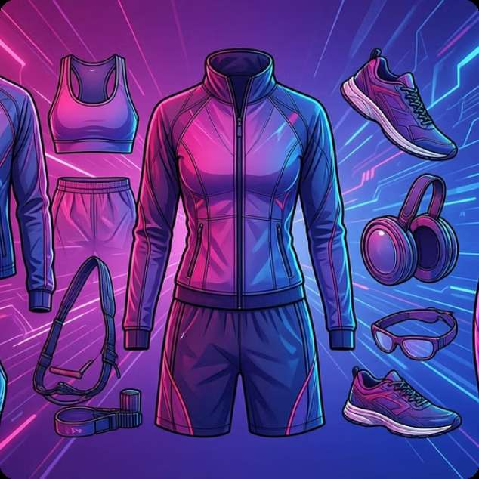
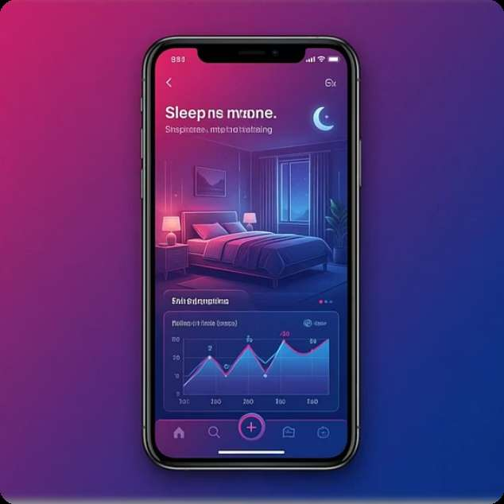
STRATEGIC OBJECTIVE
Business Objective & Subsidiary Focus
Leveraging Fitbit smart device usage trends to develop precision marketing strategies and drive customer acquisition across three key business units.
LeanFit
FitWear
Sleepy-Nights
Personalised weight-loss diet plans targeting health-conscious consumers seeking sustainable fitness solutions
Fitness gear and apparel transitioning to online expansion with data-driven product recommendations
Sleep scheduling app subscriptions focusing on users with irregular sleep patterns and quality concerns

Slide 4

DATASET
Fitbit Fitness Tracker Dataset Overview
Data Specifications
Data Categories Analysed
Source: Kaggle – Möbius
Daily Activity Metrics
Sleep Data
License: CC0 Public Domain
Steps, calories, distance, and intensity levels tracked continuously
Sleep duration, time in bed, and sleep efficiency patterns
Period: 12 March – 12 May 2016
Sample Size: 30 Fitbit users
Physiological Indicators
Heart rate variability and weight logs for health assessment

Slide 5
Key Performance Metrics
Nine critical metrics form the foundation of our customer segmentation and targeting strategy, enabling precise identification of user behaviour patterns.
Total Steps
Calories Burned
Very Active Minutes
Daily step count indicating overall activity levels
Energy expenditure measurement for fitness tracking
High-intensity exercise duration per day
Fairly Active Minutes
Lightly Active Minutes
Distance Travelled
Moderate-intensity activity duration
Low-intensity movement throughout the day
Total distance covered during activities
Sleep Duration
Time in Bed
Heart Rate
Total hours of sleep recorded nightly
Total time spent in bed versus actual sleep
Cardiovascular health indicator and intensity marker

Slide 6
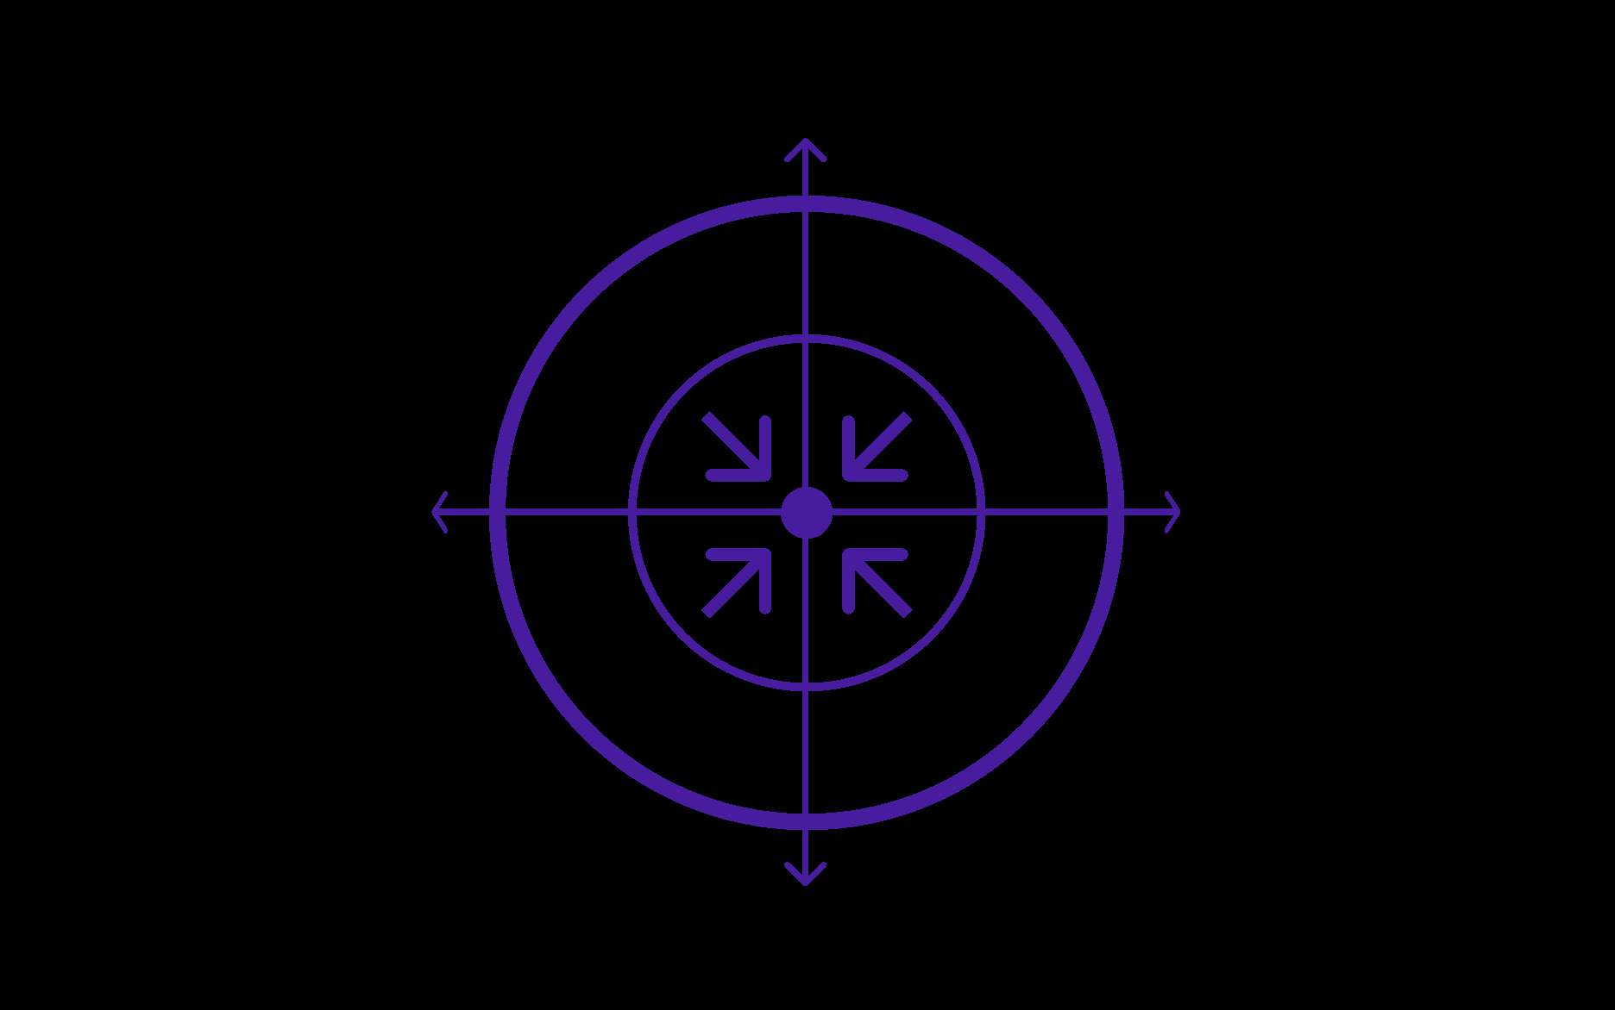
LEANFIT
SCENARIO 1
LeanFit: Targeting Weight-Loss Customers
Weight
Business Challenge
LeanFit has experienced declining sales in personalised weight-loss diet plans despite growing market demand. The objective is to identify high-potential customers most likely to invest in structured weight management programmes.
Obesity Risk
Heart Rate
Health Classification Framework
Blood Pressure
Elevated heart rate exceeding 185 bpm combined with higher BMI ranges indicates increased cardiovascular risk, creating urgency for structured weight-loss intervention.
Healthy
Overweight
Obese
BMI 18.5–24.9
BMI 25–29.9
BMI ≥30

Slide 7





DATA ANALYSIS
Customer Identification Strategy for LeanFit
High Calorie Burn
Users burning significant calories despite lower activity suggest inefficient metabolism
Heart Rate Variability
Elevated or inconsistent heart rates indicate cardiovascular stress
Low Active Minutes
Minimal very active minutes despite device usage shows sedentary patterns
Higher Weight Logs
Consistent weight tracking with elevated BMI indicates weight consciousness
These behavioural indicators collectively identify users actively monitoring health but struggling with weight management—ideal candidates for personalised diet plans.

Slide 8
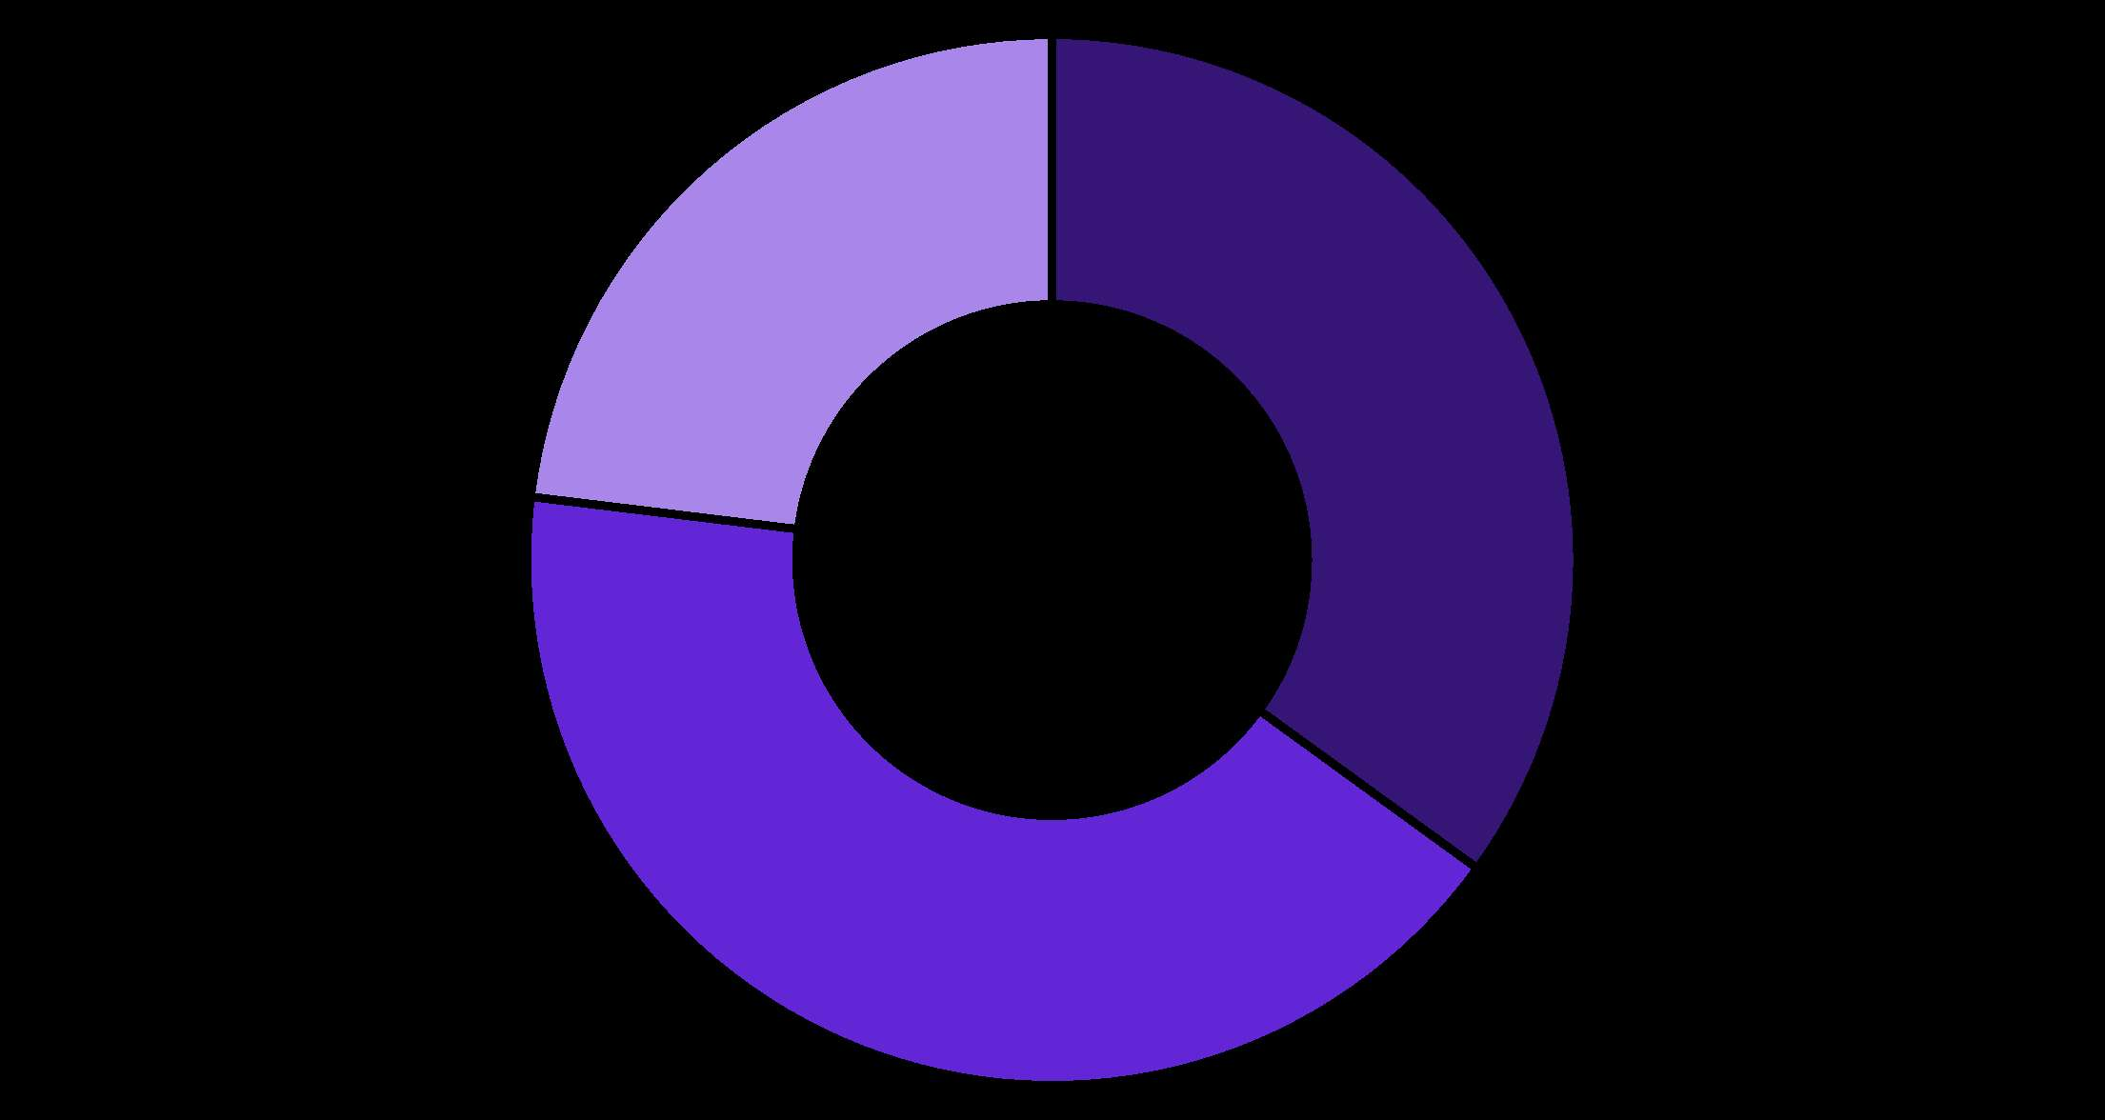
KEY INSIGHTS
LeanFit Marketing Recommendations
Analysis reveals 35% of Fitbit users exhibit characteristics indicating weight-loss potential, representing a substantial untapped market for LeanFit's personalised diet plans.
Strategic Marketing Focus
Health improvement messaging emphasising long-term wellness benefits
Blood pressure control and cardiovascular health positioning
Sustainable fitness integration with dietary recommendations
Personalised targeting based on BMI and activity patterns
Weight-Loss Potential
Maintenance Focus
Fitness Enthusiasts

Slide 9
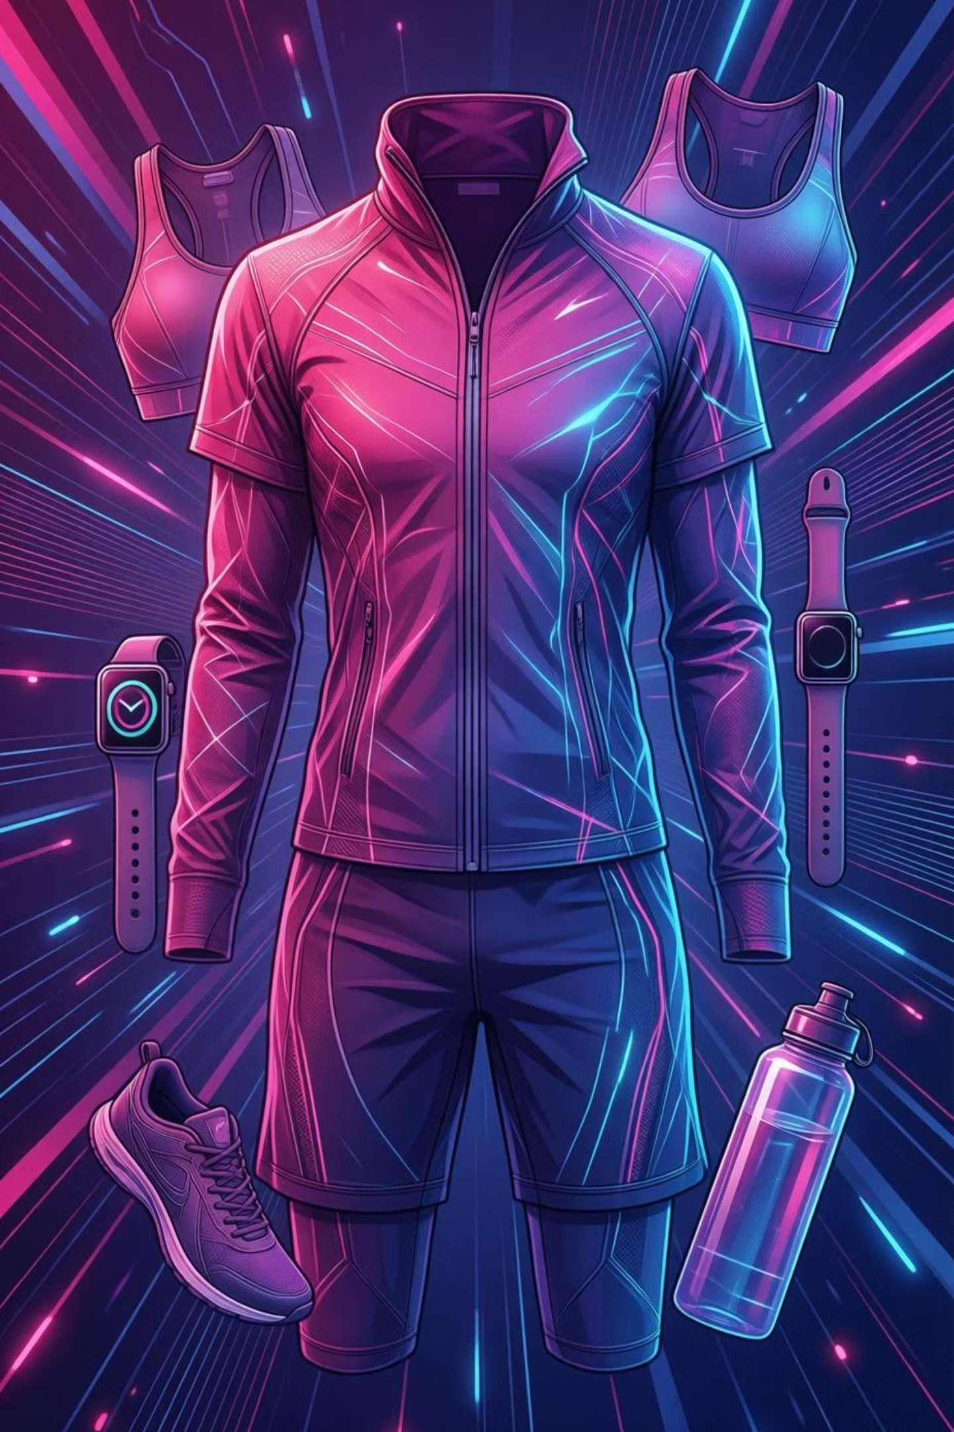
FITWEAR
SCENARIO 2
FitWear: Online Expansion Strategy
FitWear aims to transition from offline retail to online sales, requiring precise identification of high-intent buyers based on fitness behaviour patterns captured through wearable device data.
Fitness Enthusiasts
Criteria: ≥20 active days per month
Activity: Average >30 very active minutes daily
Products: Premium gear, advanced equipment, performance apparel
Fitness Starters
Criteria: ≥20 active days per month
Activity: Average >60 fairly active minutes daily
Products: Entry-level gear, basic equipment, comfortable apparel

Slide 10
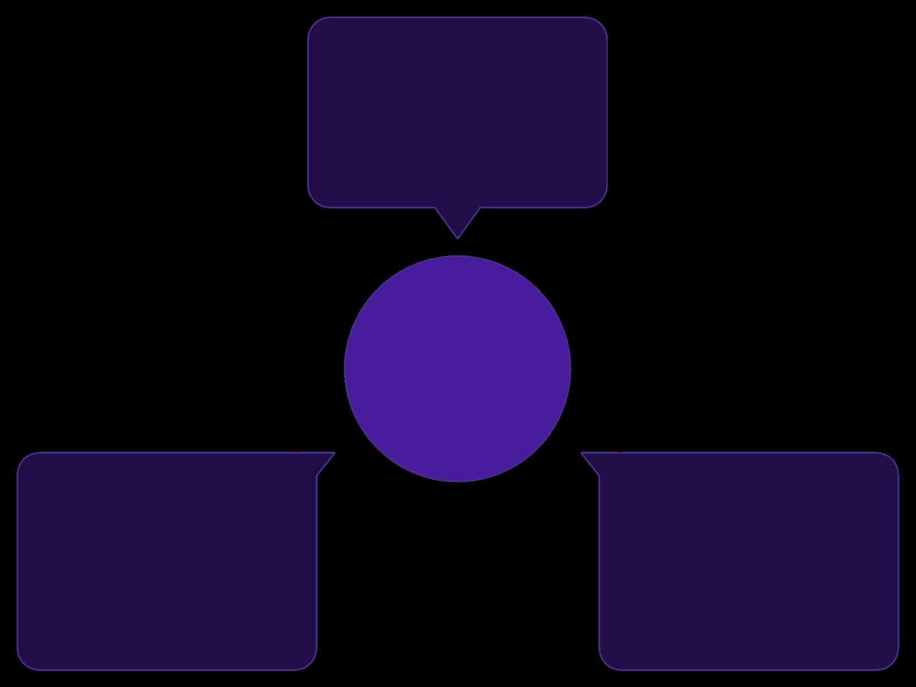
SLEEPY-NIGHTS
SCENARIO 3
Sleepy-Nights: Sleep Quality Targeting
Irregular sleep cycles
Variable sleep/wake timing
Business Objective
Identify Sleep Problem Users
Increase subscription base by identifying users experiencing poor sleep quality or irregular sleep patterns who would benefit from sleep scheduling interventions.
Sleep Deprivation Indicators
Poor sleep efficiency
Inconsistent bedtimes
Low time asleep vs. in bed
Frequent bedtime shifts
Users exhibiting these patterns combined with high device usage at night represent prime candidates for Sleepy-Nights app subscriptions offering personalised sleep scheduling solutions.
Insufficient Duration
Poor Efficiency
Irregular Schedules
Consistently sleeping less than 7 hours nightly
High time in bed but low actual sleep duration
Inconsistent bedtimes and wake times throughout the week

